Slide 1

Multilevel Modelling
An Application to the Crown Court Sentencing Survey Using SAS

Slide 2
Index
The Theory:
  Random intercepts
  Random slopes
Multilevel Modelling in SAS:
  Syntax
  Interpretation of the output
  Estimates of interest
Other uses and extensions

Slide 3
The Theory
  Multilevel modelling is just an extension of standard linear regression that can be used to relax the assumption of independence.
  Sentences from the same Court might share some characteristics, e.g. lower sentences on average in Courts where judges are more lenient.
  In this case iid is false, and unless we adjust for it SEs are going to be underestimated.
Notes:
Otherwise underestimated SEs.

Slide 4
The Theory: Random Intercepts
  We extend the standard linear regression model
  Y_{i} = α + Β_{j}X_{ij} + ε_{i}
  by breaking the residual term in two, one term capturing residuals at the level 1 (i.e. offences), and another capturing residuals at the level 2 (i.e. Courts),
  Y_{il} = α + Β_{j}X_{ij} + ε_{il} + μ_{l}
  so, we allow the intercept to be different for each cluster unit.
Notes:
We consider first a simple case of multilevel modelling, the RI model.

Slide 5
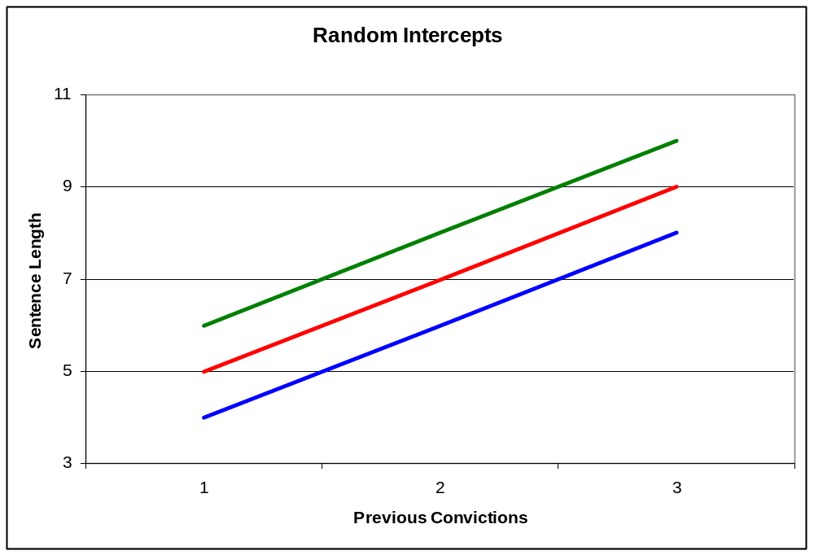
The Theory: Random Intercepts
Notes:
A simple example of a model where sentence length is regressed on previous convictions, allowing for random intercepts, and considering 3 Courts.

Slide 6
The Theory: Random Slopes
  Sometimes the intracluster dependencies cannot be characterised simply by differences in conditional means by Courts.
  Random slopes models can be used to explore whether those dependencies are also due to different effects of certain explanatory variables across Courts.
  Random slopes are specified by adding a new residual term to the slopes that we want to explore.
Y_{il} = α + (Β_{j} + ν_{jl})X_{ij} + ε_{il} + μ_{l}
Notes:
So, it is not just different means of sentence length by Court, but also different effects from other variables.

Slide 7
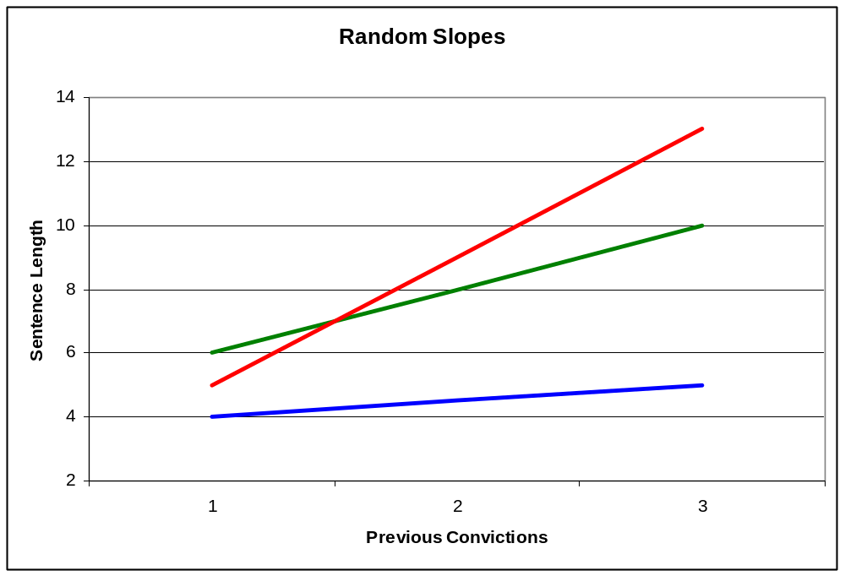
The Theory: Random Slopes
Notes:
Example of random slopes diverging as previous convictions increases.

Slide 8
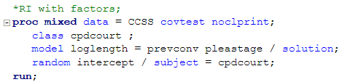
Random Intercepts in SAS: Syntax
Notes:
The procedure for multilevel modelling in SAS is proc mixed.
It has this name because MM models are also known as mixed models (because of their fixed and random parts), or random effects models.
The option covtest gives a significance test for the level 2 residuals,
noclprint tells SAS to eliminate a long column with the names of the cluster units that are used.
Class indicates which of the variables to be used in the procedure are categorical.
After model we indicate the fixed effect part of the model (only two variables where included here for reasons of space),
solution asks for the fixed effect part of the output, the coefficients of the explanatory variable.
After random we include the parts of the model that we want to be considered as random parts, in this case just the intercepts,
and after subject we include the variable which identifies the level 2 units.

Slide 9
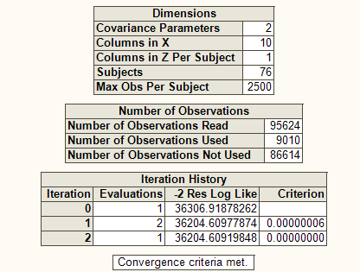
Random Intercepts in SAS: output
Notes:
I show here some of the most important things to consider form all of the results given by SAS.
The covariance parameters indicate the number of residual terms that had to be estimated,
In the case of the RI model, these are the level 1 and the level 2 residual terms.
Subjects indicate the number of level 2 units (Courts), and number of observations used indicate the level 1 units (offences).
I don’t know much about the estimation method, but if the algorithm does not converge it is indicated here.
This can be the case when specifying a too complex random structure, while not having enough cases.

Slide 10
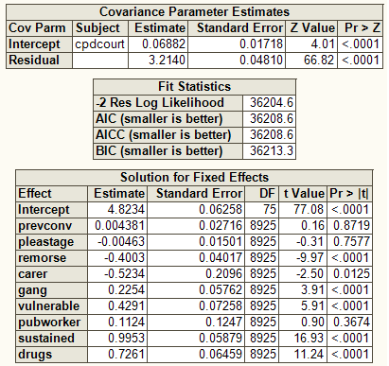
Random Intercepts in SAS: output
Notes:
This second part of the results is more interesting.
In the first table we have estimates for the variance of the level 2 and level 1 residual terms, the first would be the random intercepts term, and we also get p-values since we asked for them with the covtest option. In this case the random intercepts term is statistically significant for a significance level of .05.
The second table gives us different measures of goodness of fit, which we can use when comparing nested models.
Finally we get estimates from the fixed part of the model, these only come up if we inlcude the solutions option.

Slide 11
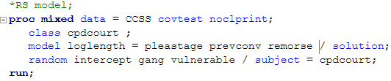
Random Slopes in SAS: Syntax
Notes:
Everything is the same as before with the exception that now we include some regressors after random to represent that we want random slopes for these variables.

Slide 12
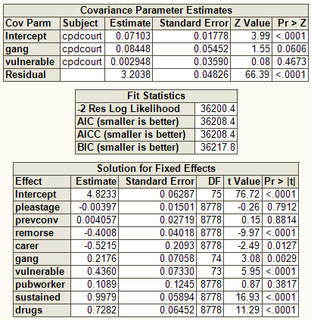
Random Slopes in SAS: Output
Notes:
and the main difference in the SAS output is just that now we get estimates of the variance of the random slopes for gang and vulnerable.
In this case non is significant.

Slide 13
Estimates of Interest
Statistical significance of the random terms.
Effect size:
  Intra-cluster correlation:
  ICC = var(μ_{l}) / (var(μ_{l}) + var(ε_{il} ))
  Confidence intervals:
  CI = exp(α + Β₁ ± log(1.96) * sqrt(ν₁))
Notes:
So once we are happy with our model, the things to report would be statistical significance of the random terms and different effect sizes.

Slide 14
Extensions
Higher number of levels, cross-classified effects,
Longitudinal Data Analysis,
Network Analysis,
More complex modelling and applications can be found at the Centre for Multilevel Modelling from the University of Bristol,
http://www.bristol.ac.uk/cmm/
Notes:
In longitudinal analysis the level 2 units are the subject and the level 1 the observations,
In network analysis the level 2 units are also the subjects, while level 1 observations might be their interactions with other subjects.

Slide 15

Questions?

